Slide 1


Welcome to English for Programming
Week 2 Class 2
<a href="https://storyset.com/work">Illustration by Freepik Storyset</a>

Slide 2

Topics for today
Review the content from your asynchronous sesison
Describe routines and objects using prepositions
Pronounce the final -s in regular plural nouns
Read effectively by using predicting, skimming and vocabulary skills

Slide 3
Checkpoint – Review
1. How was your experience with the asynchronous session?
Share your opinion and ask a different partner
Good
Acceptable
Very good
My experience was______,
how about you?
Bad
Excellent

Slide 4
Mention two things that you learned and two things that you
did not understand, then share with others and ask.
Learned
Did not understand
I learned…
I did not understand…
How about you?
Notes:
Teacher could use annotate in Zoom for everybody to participate

Slide 5

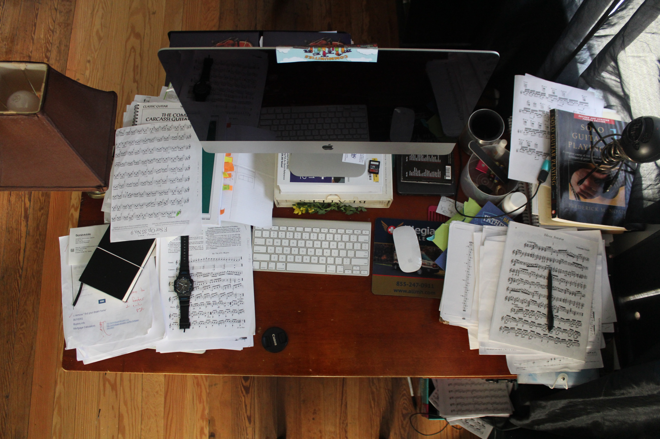
Warm up: Is your office…
tidy?
untidy?
Photo by Nikolay Tarashchenko on Unsplash
Photo by Jesus Hilario H. on Unsplash
Model answer: My office is usually…

Slide 6

Explore
What do you have in your office?
Make a list of objects that you can find at the office
How many objects can you think of?
For example:
Computer
USB Flash drive
…
Photo by Serpstat from Pexels
You have 2 minutes to make a list

Slide 7


Do you know the difference between singular and plural?
<a href="https://storyset.com/technology">Illustration by Freepik Storyset</a>

Slide 8
Mouse
Charger
Mousepad
Computer
Notebook
Scanner
1
Printer
Laptop
USB Flash drive
Complete the chart with the following words.
Folder
Keyboard
Tablet
Plural
Singular
2
What do you notice? What is the rule for plurals?
A computer
Two computers
Add –S if a word ends with a vowel
Add –ES if a word ends with a consonant
3
Notes:
T first does the exercise with students, tehn asks what they noticed, then gives the rule. The animations help you follow the steps.

Slide 9
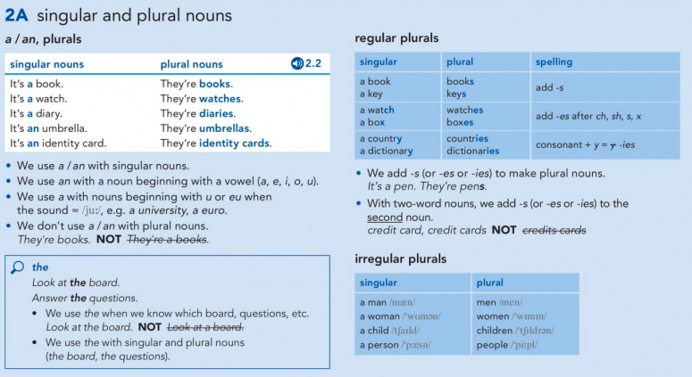
Singular and Plural Nouns

Slide 10

But, how do we pronounce plurals?
Group Chat made by StorySet <a href="https://storyset.com/social-media">Illustration by Freepik Storyset</a>

Slide 11
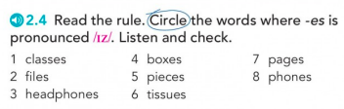

Pronunciation
Final –s and -es
Scanner | Laptops Notebooks Tablets
Zoom | Folders Flash Drives
/IZ/ | Watches Boxes Devices
Notes:
Play the track 2.4 to check the r pronunciation with your students. The track is shared in your weekly materials.

Slide 12
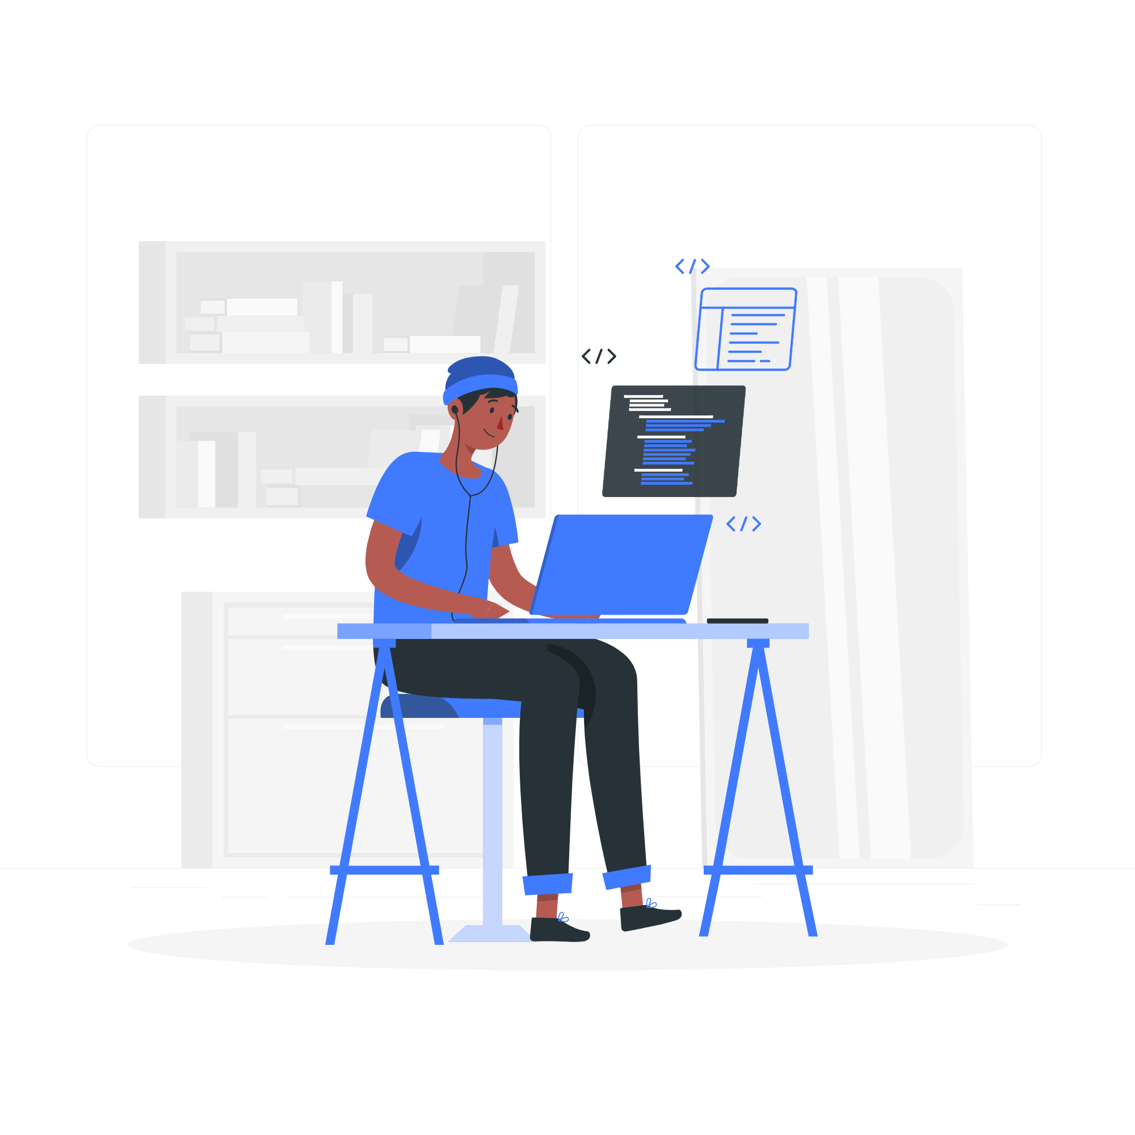
You will sometimes need to say numbers, especially in coding
Coding Flat made by StorySet: <a href="https://storyset.com/web">Illustration by Freepik Storyset</a>

Slide 13
Zero /ˈzɪroʊ/ | 0 |  | 11
 | 1 | Twelve /ˈtwɛlv/ | 12
Two /ˈtuː/ | 2 |  | 13
Three /ˈθriː/ | 3 | Fourteen ˌfôrˈtēn | 14
 | 4 |  | 15
 | 5 |  | 16
Six /ˈsɪks/ | 6 | Seventeen /ˌsɛv^{ə}nˈtiːn/ | 17
 | 7 |  | 18
 | 8 |  | 19
Nine /ˈnaɪn/ | 9 | Twenty /ˈtwɛnti/ | 20
 | 10
Your dictionary shows the transcription
Write the missing numbers
Look up the missing transcriptions on
https://www.wordreference.com/
Look at the phonetic transcription. How do you pronounce these numbers?
Notes:
Teacher uses this slide to teach how to check the pronounciation in a dictionary. T tells students to hear the pronounciation but also to elarn how to read the symbols.

Slide 14

As you could see, we can use dictionaries to learn..
The meaning
The pronunciation
Nerd Isometric made by StorySet: <a href="https://storyset.com/people">Illustration by Freepik Storyset</a>

Slide 15

Look at the photo
What plurals can you see? Pronounce them.
How many elements of each category?
Example:
There are eight co-workers.
Photo by fauxels from Pexels
Notes:
Ask Ss and give them time to practice, make sure they pronounce correctly the s endings. T uses annotate option on Zoom to help students notice and pronounce. This activity can be done with the whole group or in breakout romos-T decides.

Slide 16
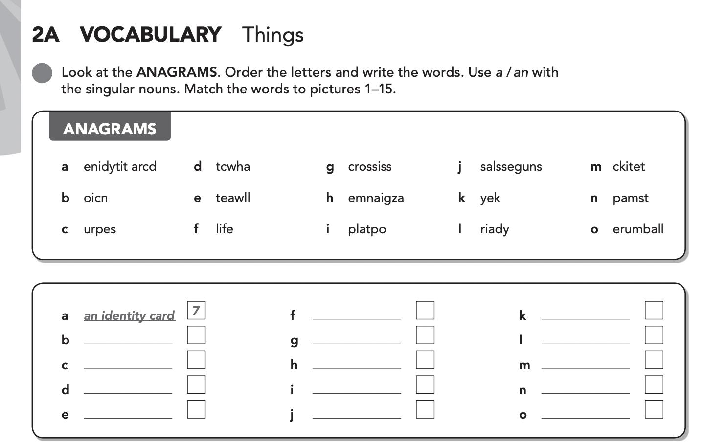
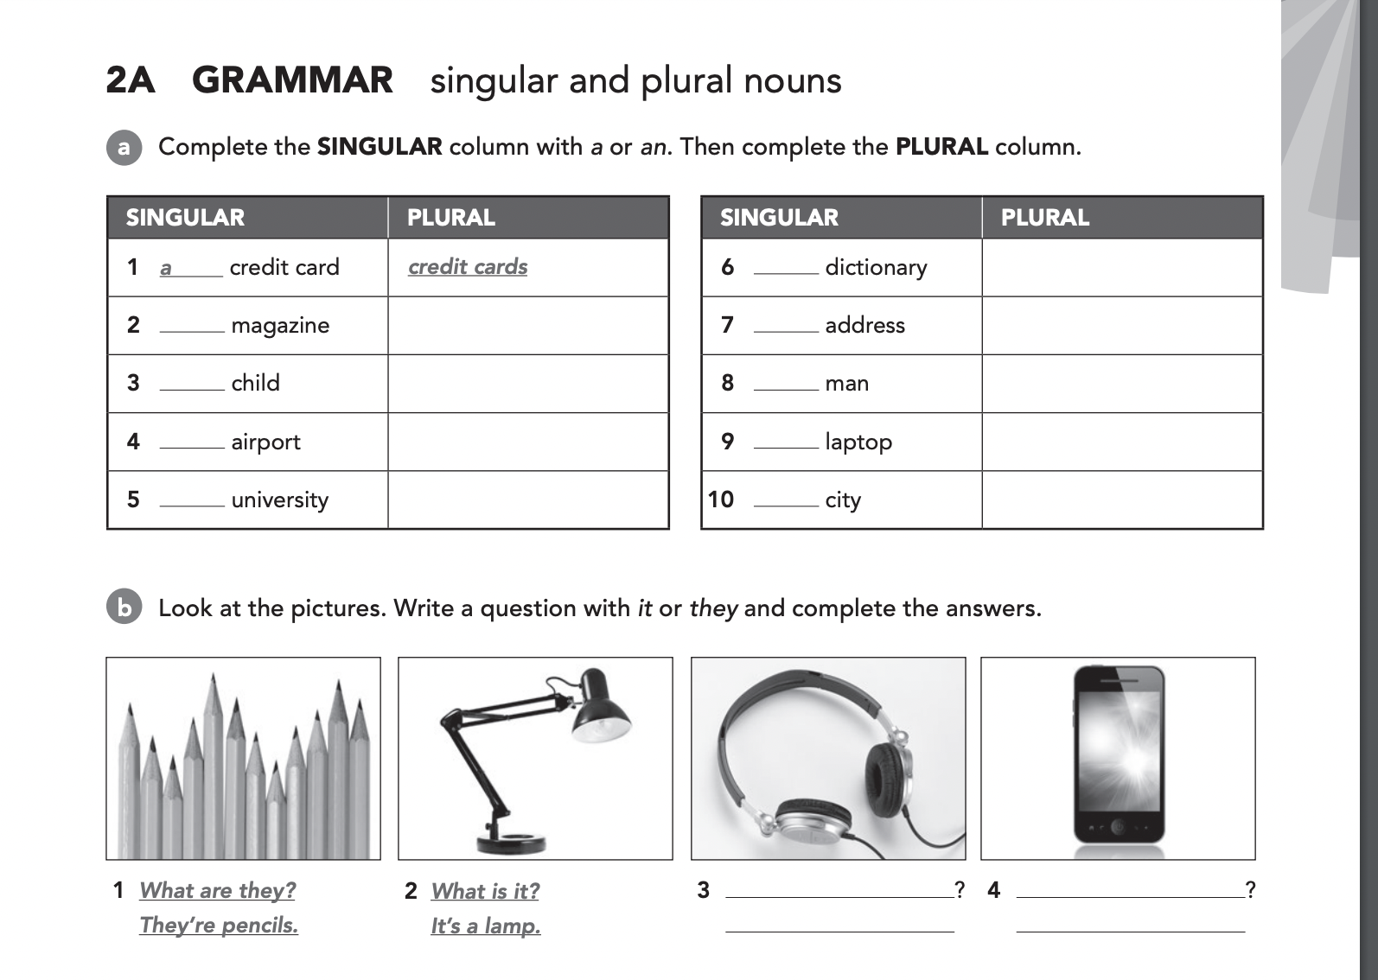
Let’s practice
Notes:
T sends students into breakout rooms and gives them around 10 min for both activities. T shares the documents on zoom. If they do not manage to do all, T sends one for homework.

Slide 17
How do we use prepositions?
At
To tell specific time
See you at 5 pm.
To point to a specific place
See you at the office.
4
To say that something happens on a specific day or date
I don’t work on Saturdays.
I start my holidays on the 25^{th.}
on
To say that something is over a surface
It is on the table.
under
To say that something is below
The CPU is below the desk.
Inside/within a period of time
I usually workout in the morning or in the evening.
I start my holidays in March.
in
Physically inside
My agenda is in the drawer.
Notes:
Complete the sentences with verb to be present (+/-)

Slide 18
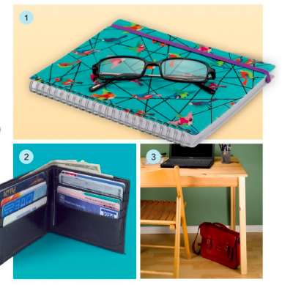
Look at the photo, complete the sentences with in, on under.
The glasses are ____ the notebook.
The credit cards are _____ the wallet.
There is a bag _____ the desk.

Slide 19

More Practice
Read the conversation with your partner and complete the dialogue
4
Ricardo:
Maria:
Ricardo:
Maria:
Ricardo:
Maria:
Ricardo:
Maria:
Hi Maria, what time do you start working tomorrow?
Hey Ricardo, well, I arrive ____ the office… I think at 7:10am, and you?
I start at 1pm. I work from home tomorrow____the morning .
Oh, nice. Hey, can you please pass my cellphone? It’s ____ the desk
Sure, no problem.
Wait, no. That is not my cellphone, let me check _____ my bag… Where is my bag?
______ the chair, look.
Thanks, oh my God it’s 8pm I have to go home!
Online page Isometric illustration made by Storyset: <a href="https://storyset.com/online">Illustration by Freepik Storyset</a>
Notes:
T tells students to take a screenshot because they will have 5 min to read it aloud and fill in the gaps in pairs(breakout rooms)

Slide 20
Answers
4
Read the conversation with your partner and complete the dialogue
Ricardo:
Maria:
Ricardo:
Maria:
Ricardo:
Maria:
Ricardo:
Maria:
Hi Maria, what time do you start working tomorrow?
Hey Ricardo, well, I arrive at the office… I think at 7:10am, and you?
I start at 1pm. I work from home tomorrow in the morning .
Oh, nice. Hey, can you please pass my cellphone? It’s on the desk
Sure, no problem.
Wait, no. That is not my cellphone, let me check in my bag… Where is my bag?
Under the chair, look.
Thanks, oh my God it’s 8pm I have to go home!
Notes:
Complete the sentences with verb to be present (+/-)

Slide 21

Reading Strategy: Skimming
Search made by StorySet: <a href="https://storyset.com/web">Illustration by Freepik Storyset</a>

Slide 22

Explore Skimming
Instructions:
Step 1: Take a look at the text in your worksheets (Sin mirar las preguntas o la hoja de respuestas).
Step 1: In groups, create a list of 3 steps that you follow if you have to read the text.
Step 2: Get ready to share the list with the group.
Remote Team made by StorySet <a href="https://storyset.com/work">Illustration by Freepik Storyset</a>
Notes:
Here, T shares a Padlet or a Jamboard so that students can share their lists. After they get back from breakout rooom, T shares the screen and goes over the answers. T uses this as a teaching opportunity to explain the steps when skimming.

Slide 23

What is skimming?
Skimming means reading:
Titles
Subtitles
First and last sentence of each paragraph
Visual help
Skimming refers to looking only for the general or main ideas.
Skimming works best with non-fiction (or factual) material- such as materials for programming!
Seatch made by <a href="https://storyset.com/web">Illustration by Freepik Storyset</a>
Notes:
Answers: (1-d, 2-c, 3-b, 4-e, 5-a)

Slide 24

Reading Strategy: Skimming
Predict what the text is about
Decide what to read and what to skip
Know where to look for specific information when you scan
Search engines made by StorySet: <a href="https://storyset.com/web">Illustration by Freepik Storyset</a>

Slide 25

Discover
In your groups, you are going to work on a worksheet.
Instructions:
Step 0: Open the document
Step 1: One person shares the screen so every student can see the questions and discuss.
Step 2: Read the instructions for every section carefully.
Your teacher will visit the groups. You have 30 min for this activity.
Team page Isometric Illustrations
made by Storyset: <a href="https://storyset.com/business">Illustration by Freepik Storyset</a>
Notes:
Answers: 1. a. isn’t b. isn’t c. aren’t 2. a.F b. T

Slide 26

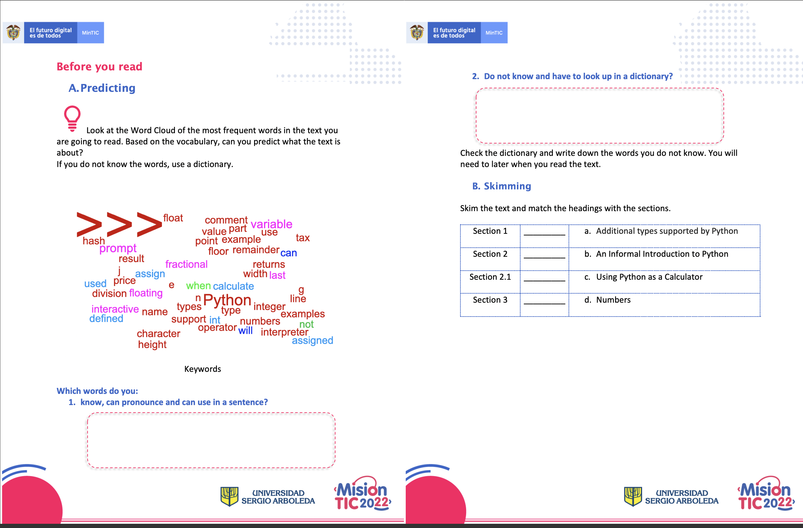
Download the word document from the chat.
Worksheet
Notes:
Teachers sends the worksheet on Zoom. Remeber to share the version WITHOUT the answer key and in WORD so that the students can edit.

Slide 27

Wrap up
Let’s check the answers!
4
Any questions?
Consulting Flat Illustration made by Storyset: https://storyset.com/illustration/consulting/rafiki

Slide 28

Autonomous
Asynchronous work
First Reading Challenge!
10% of your course grade
Deadline to take it: By Sunday midnight

Slide 29
See you in your net class when you will learn about:
Adjectives
Reading strategy: Scanning

Slide 30
Thank you!

